Slide 1



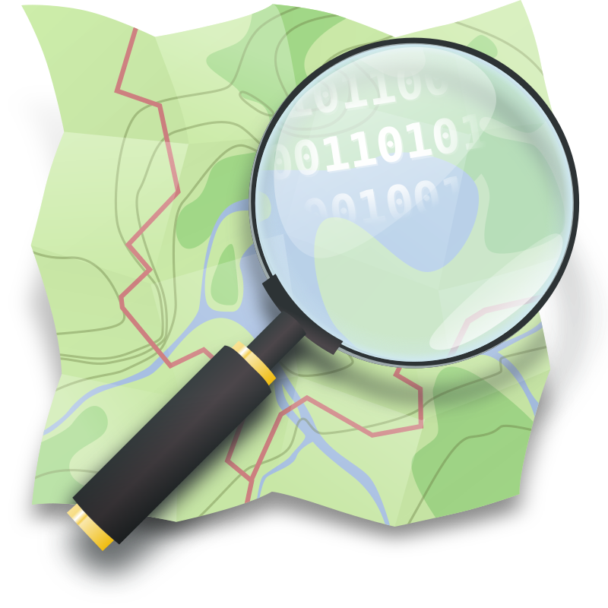



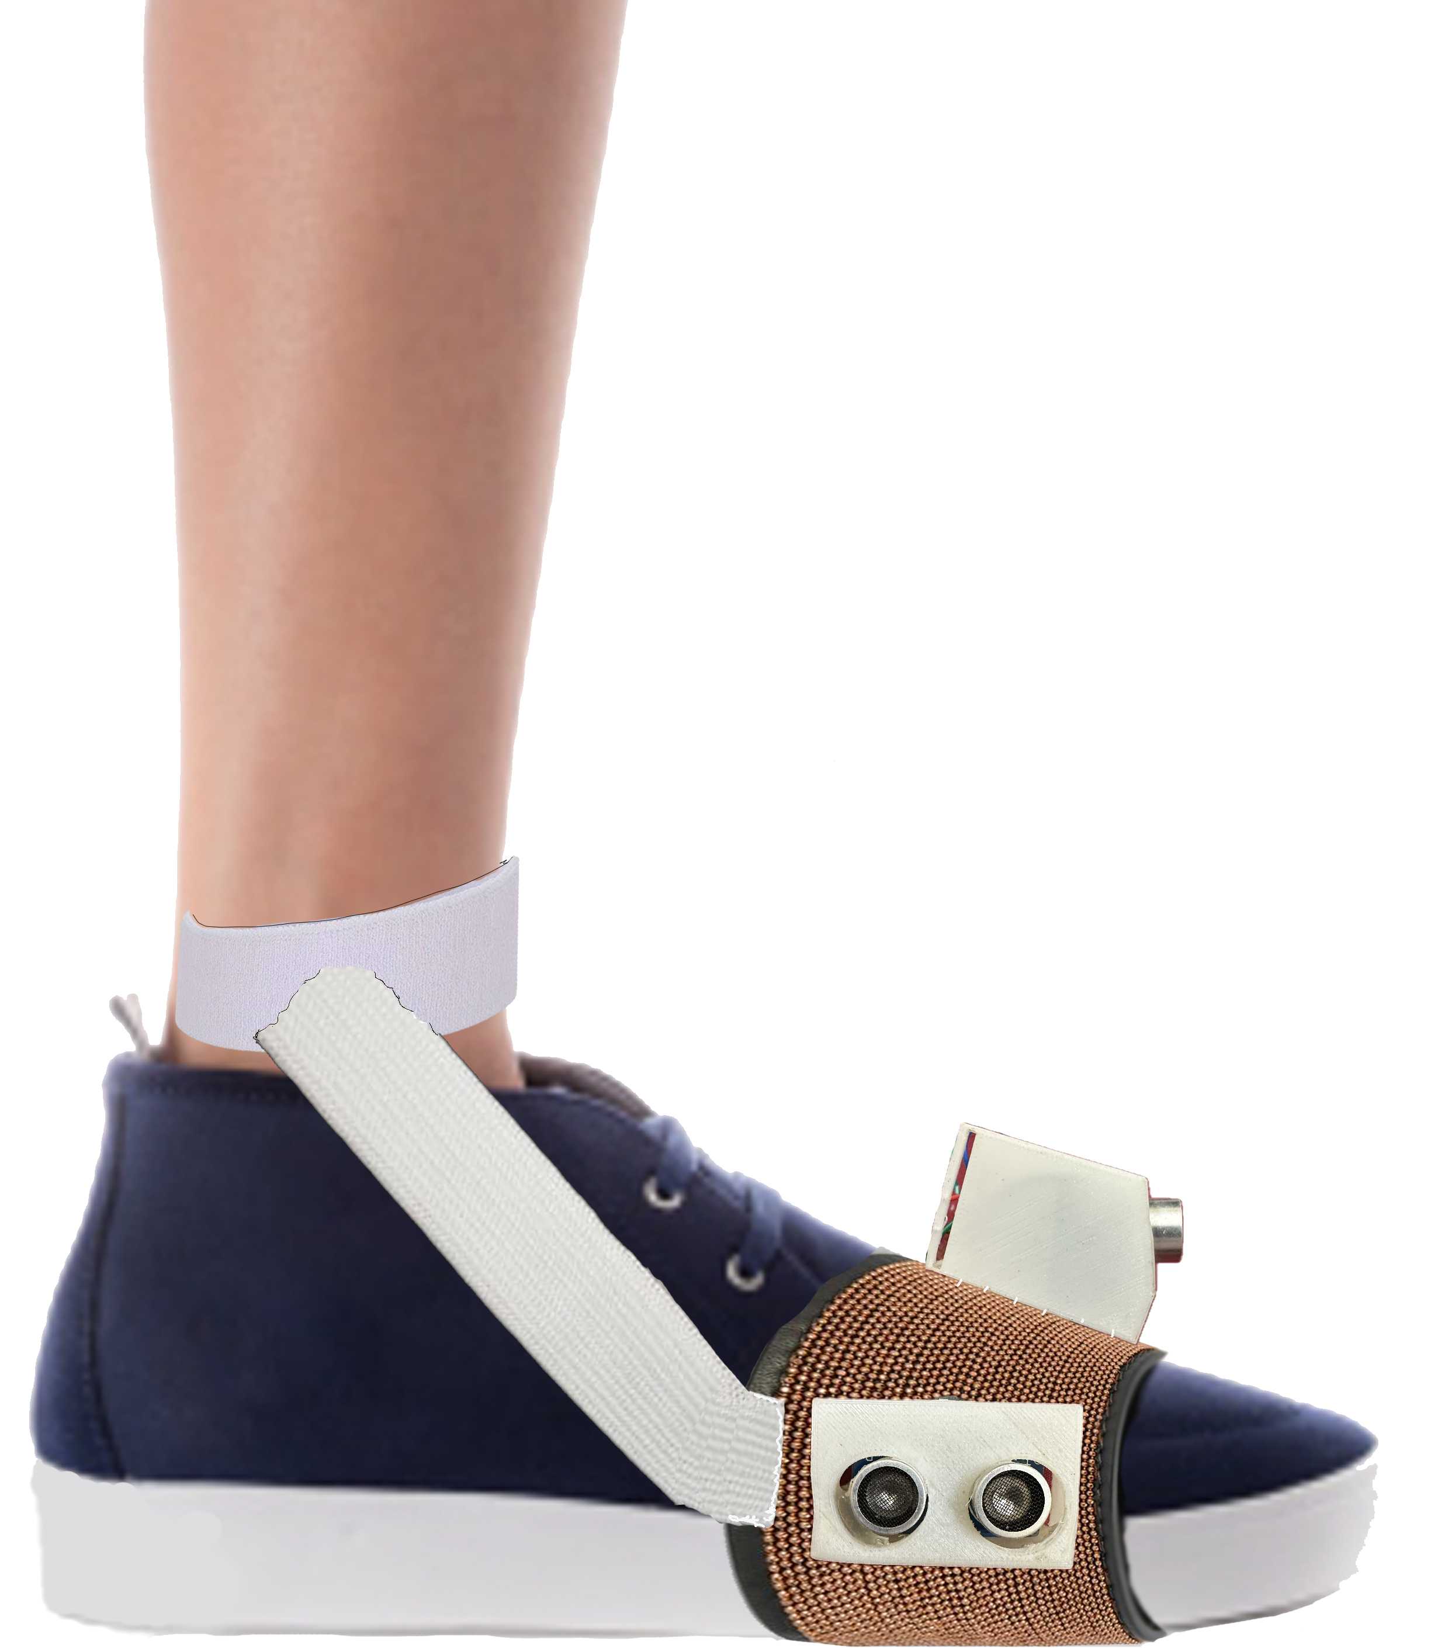
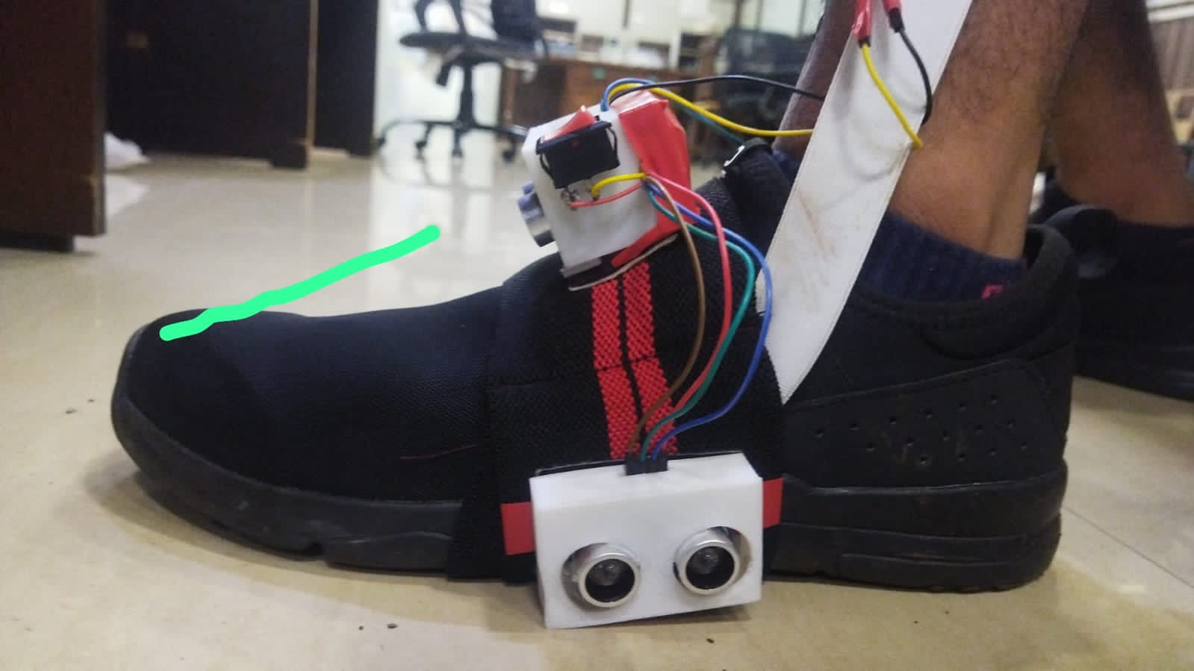
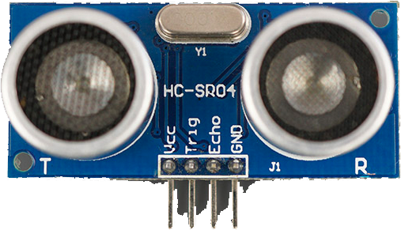


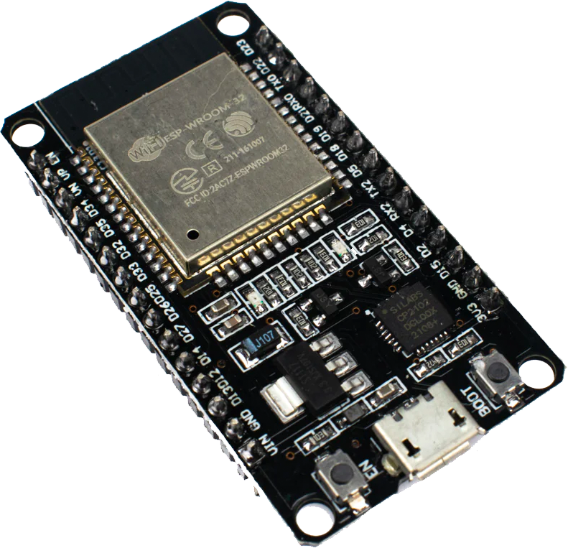
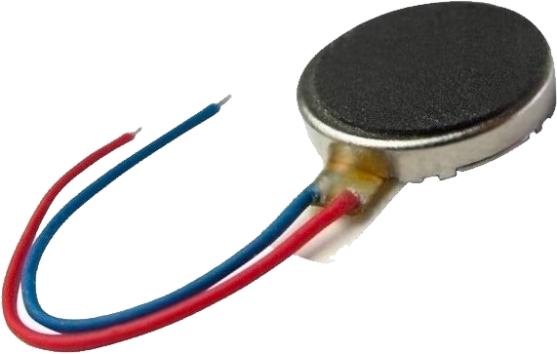
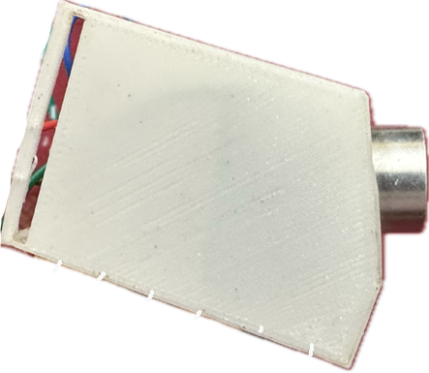
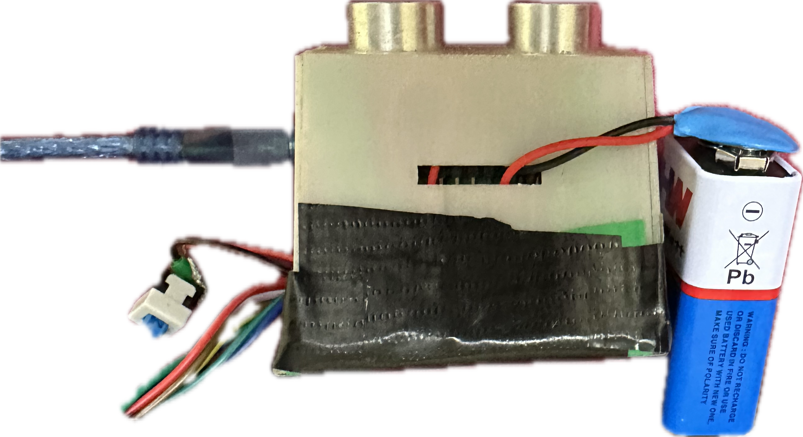
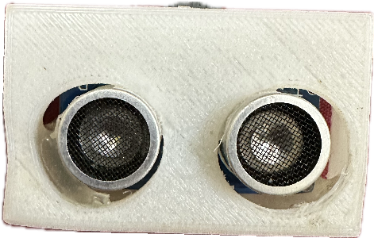
Institute Technical Summer Project 2023
iKshana
Abhineet Agarwal, Chinmay Moorjani, Yash Bhake, Tanish Raghute | Ojas Jain
Our product consists of a harness which can be strapped on any shoe to help people with visual impairments navigate through their lives.
It will consist of the following features:
Long range navigation via using location data from the user’s phone and then using vibrational cues to relay the information.
Short range navigation coupled with obstacle avoidance using ultrasonic sensors and vibration actuators.
Photoshop and Illustrator (Modelling)
Fusion 360 (Modelling)
Android Studio, Fused Location Provider (FLP) client, Open Street Map (OSM), Osmium library
Circuitry, Soldering, Power management, a bit of Microcontroller and Analog theory, reading datasheets.
Stitching, Mechanical Design, PCB Design
Mechanical design successfully implemented → 2 iKshanas made.
Both support navigation aid through obstacle detection & intersection maneuvering.
Android app which obtains the user’s location, and utilizes data about intersections and sends data to ESP-32 with Wi-fi modules when required to help the user navigate them.
A JSON database containing data about all intersections at IIT Bombay.
A complete circuit consisting of an ESP-32 with Wi-fi modules, 2 ultrasonic sensors & 2 vibration motors on each foot.
3D printed containers to fit our circuitry - iKshana modules
Introduction or Abstract
Tools & Techniques Learned
Results
Our objective is to provide a more convenient solution to the issues visually impaired people face as they navigate, while keeping it affordable so we’re able to reach the class of people most affected.
Through this, we hope to boost the self-confidence and self-sufficiency of the less-sighted and unsighted.
Software
Machine learning algorithms can be used to make our model more accurate for daily routine commute.
We want to replace ultrasonic sensors with cameras and state-of-the-art computer vision algorithms to make our product more accurate and safer.
Mechanical & Electrical
We want to work on the power supply front. We plan to use piezoelectric motors coupled with batteries to charge them from the user’s motion.
Design PCBs and get them manufactured to have more reliable electrical systems.
Objectives
Future Plan

